Slide 1
MAHATMA GANDHI COLLEGE IRITTY UNIT NO:- 30 & 63 2022 - 23
NATIONAL SERVICE SCHEME

Slide 2
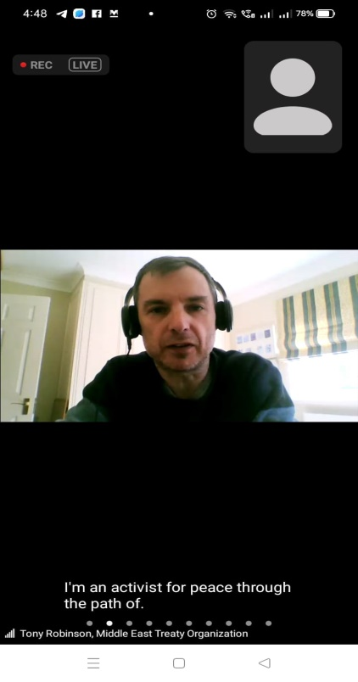
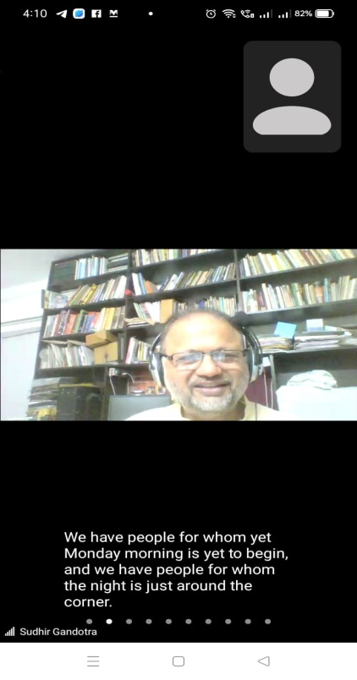
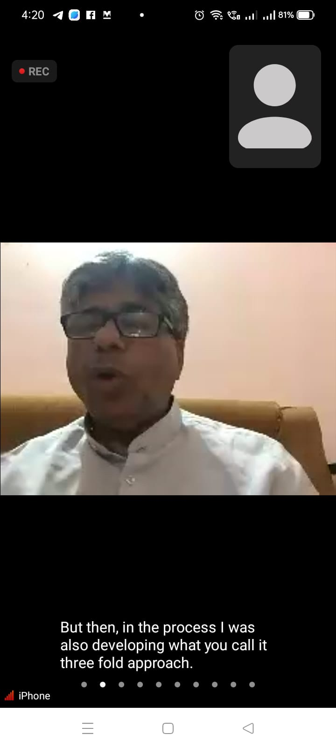
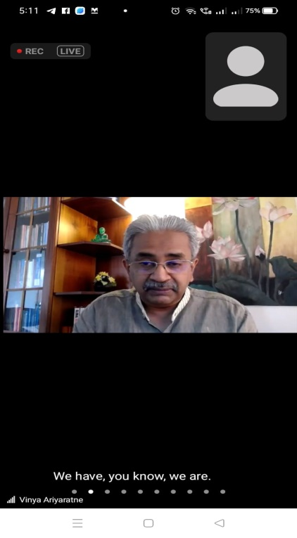
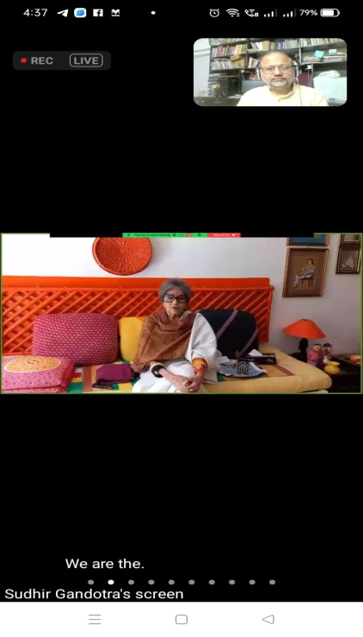
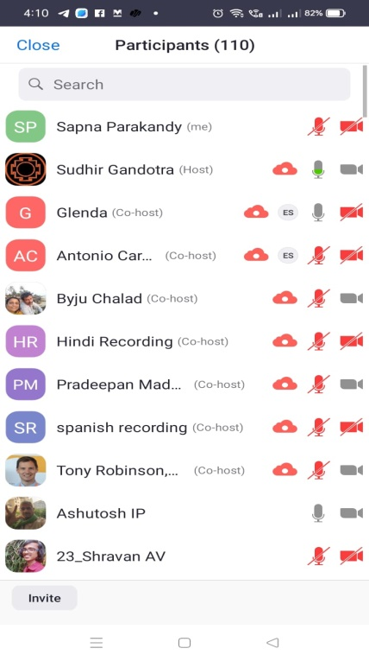
3 APRIL 2022
Asia Peace Conference
Volunteers Attended Asia peace conference conducted in collaboration with world without war and violence team kannur through online mode
Notes:
Mxnnxxnx

Slide 3
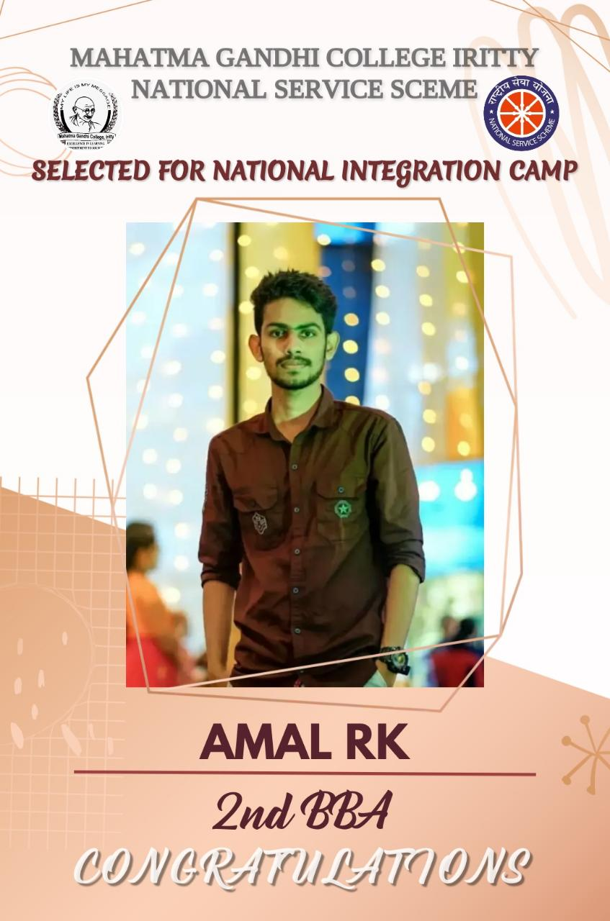
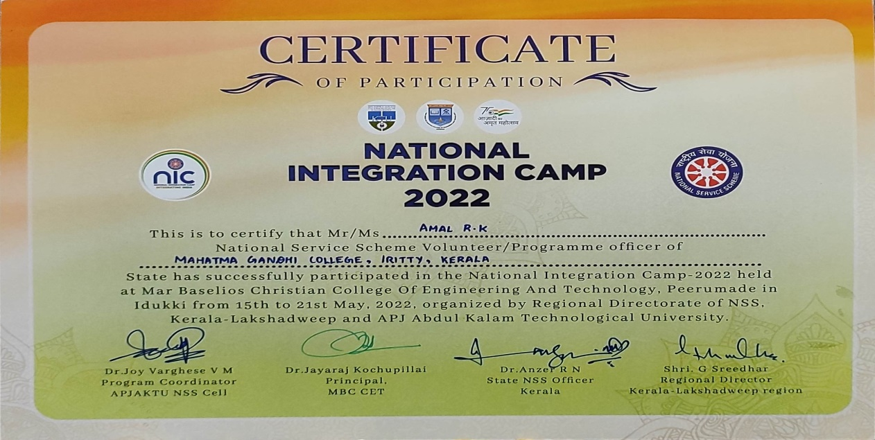
23 April 2022
Our volunteer Amal RK selected to attend the National Integration Camp
Notes:
Mxnnxxnx

Slide 4
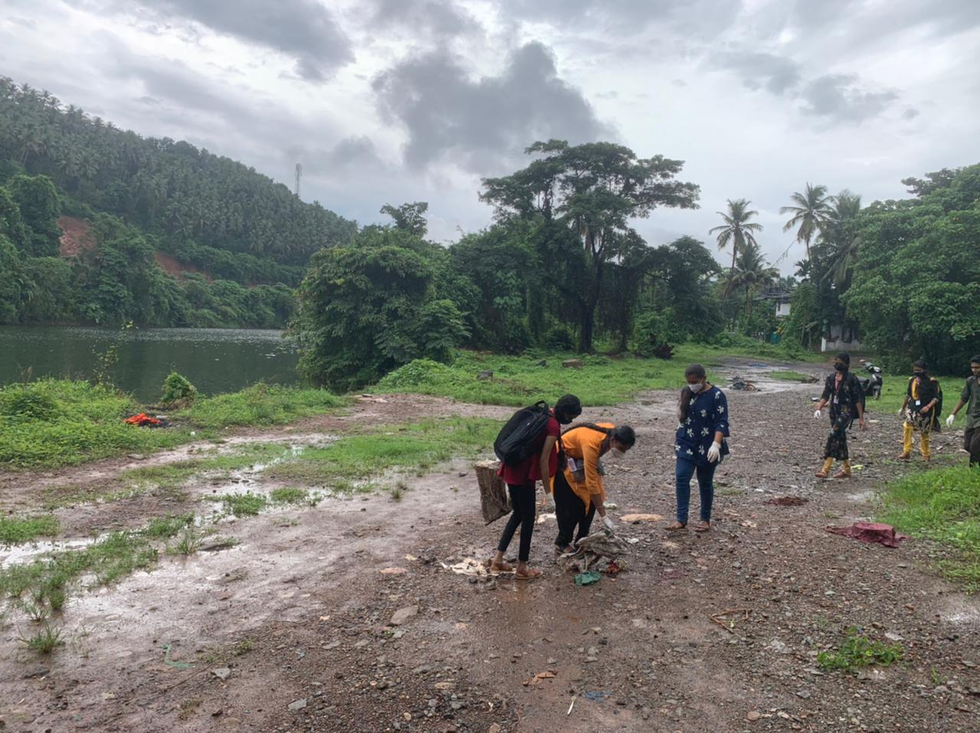
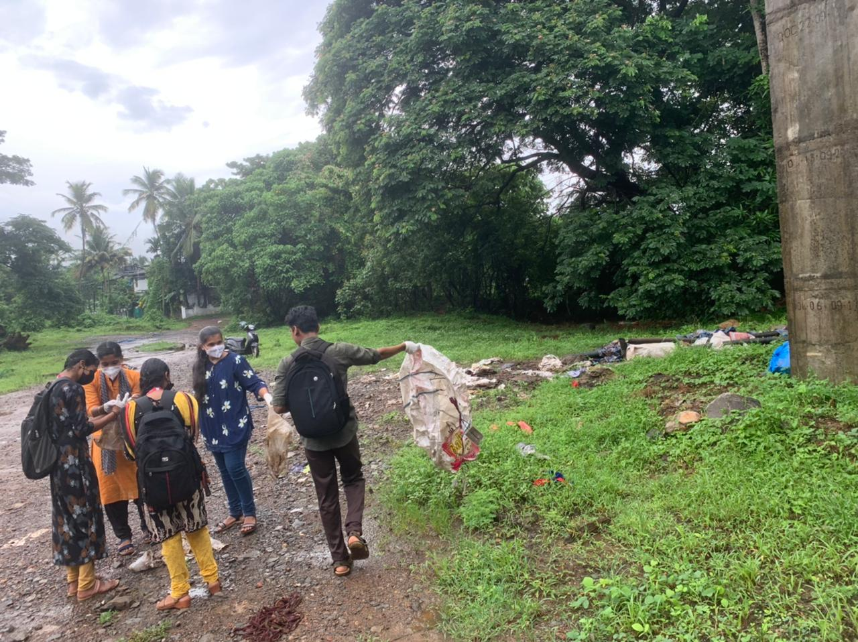
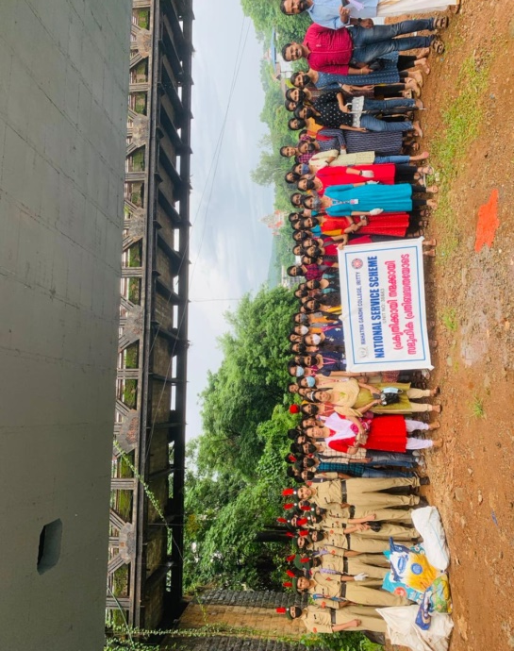
17 May 2022
Pre-Monsoon CleanUp
NSS volunteers and NCC cadets from Mahatma Gandhi College jointly conducted a pre-monsoon clean-up at iritty as part of the fresh water flow project.
Instagram link
Notes:
Mxnnxxnx

Slide 5
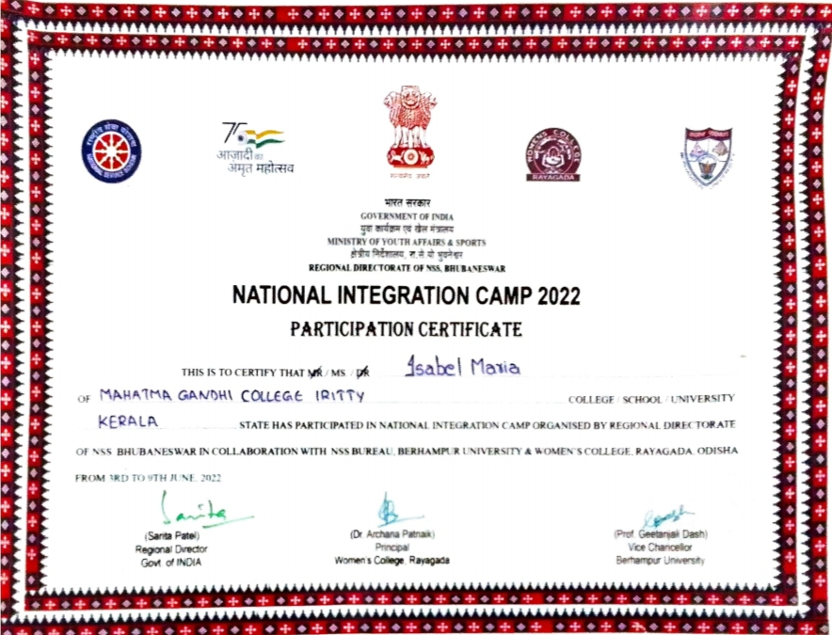
23 May 2022
Our volunteer Isabel Maria was selected to attend the National Integration Camp- Orissa
Notes:
Mxnnxxnx

Slide 6
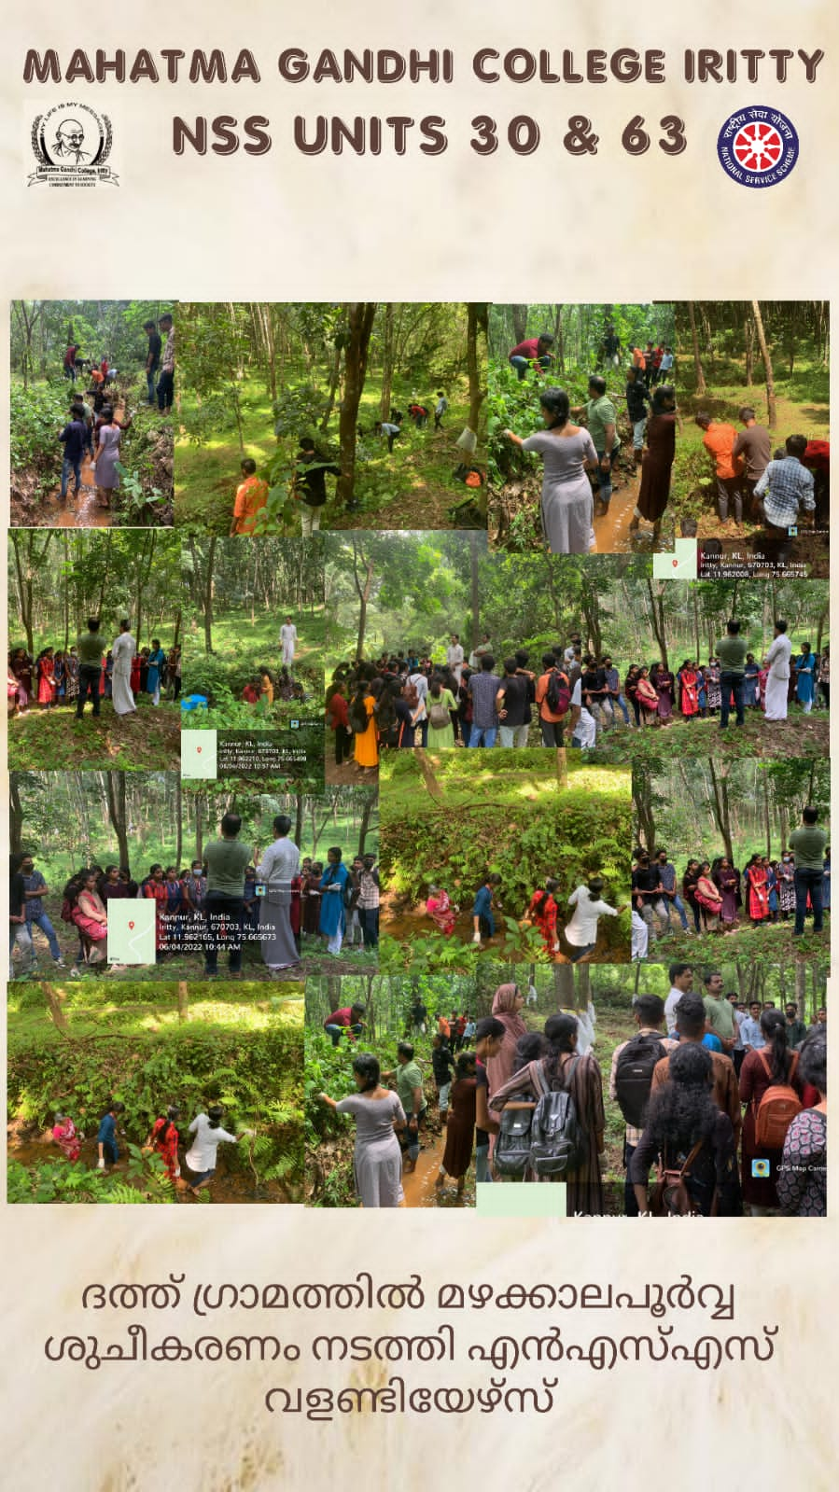
4 June 2022
Pre-Monsoon CleanUp
Volunteers carried out pre-monsoon clean-up in the adopted village
Instagram post
Notes:
Mxnnxxnx

Slide 7
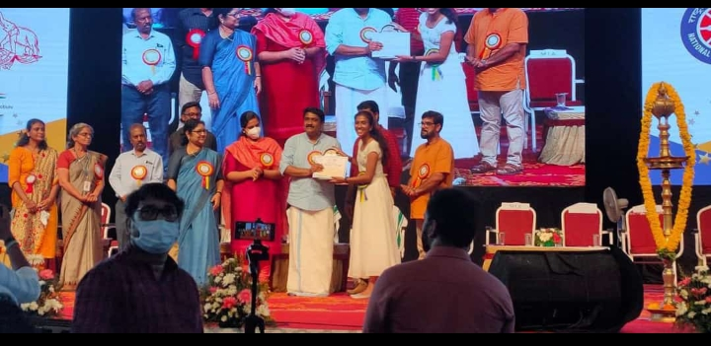
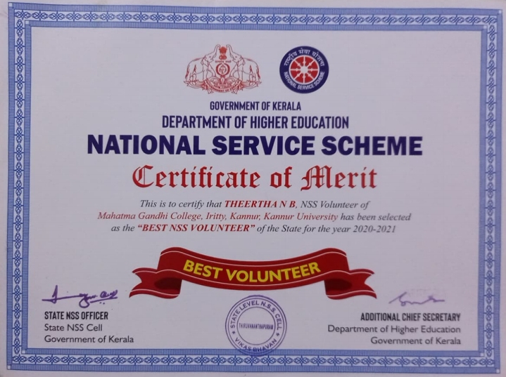
9 June 2022
Our volunteer Theertha received the State Award for the Best NSS Volunteer
Notes:
Mxnnxxnx

Slide 8
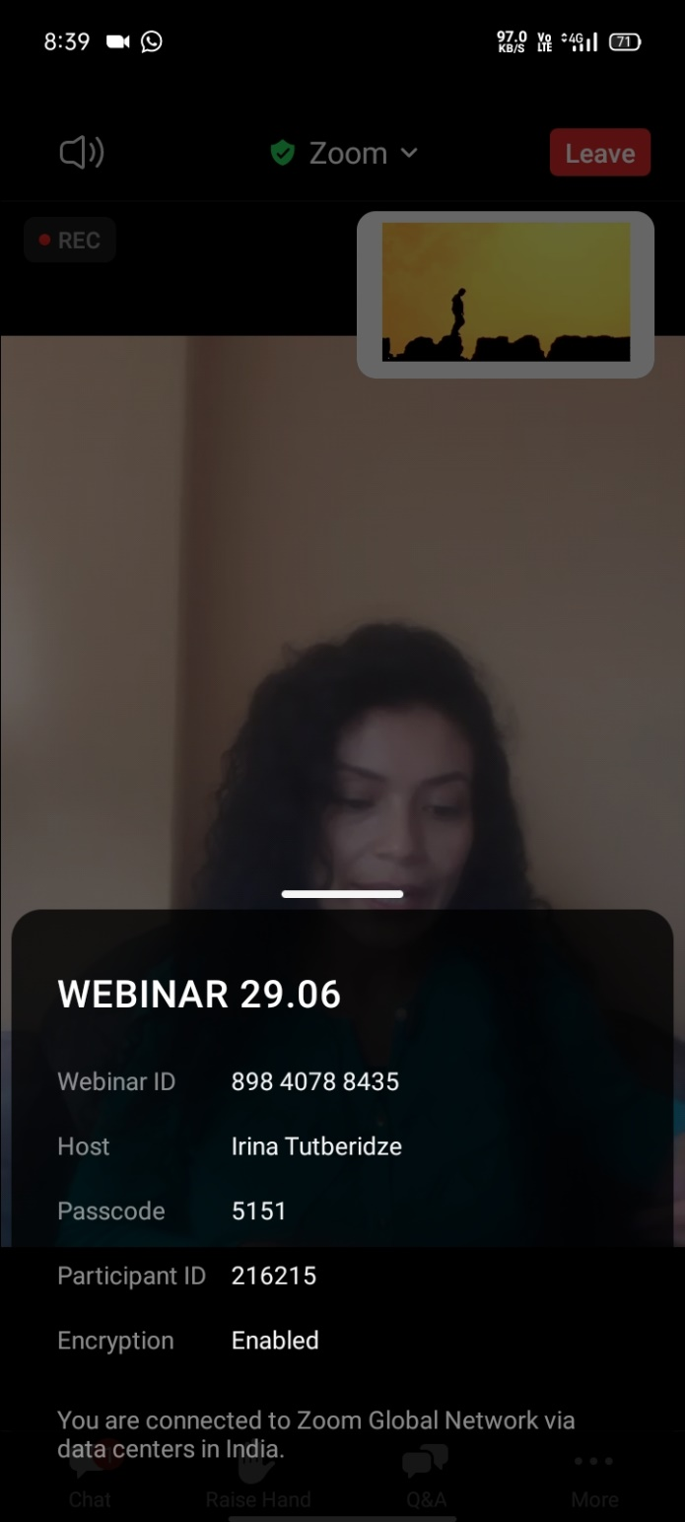
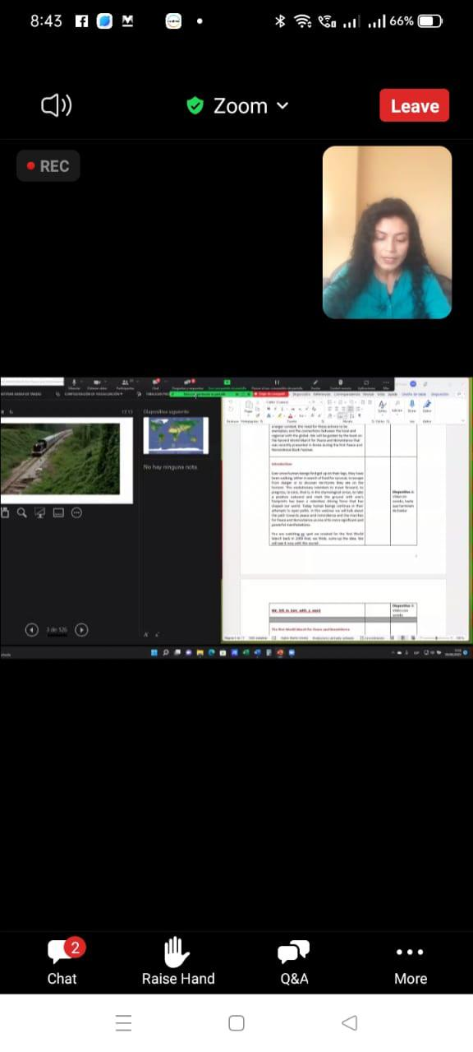
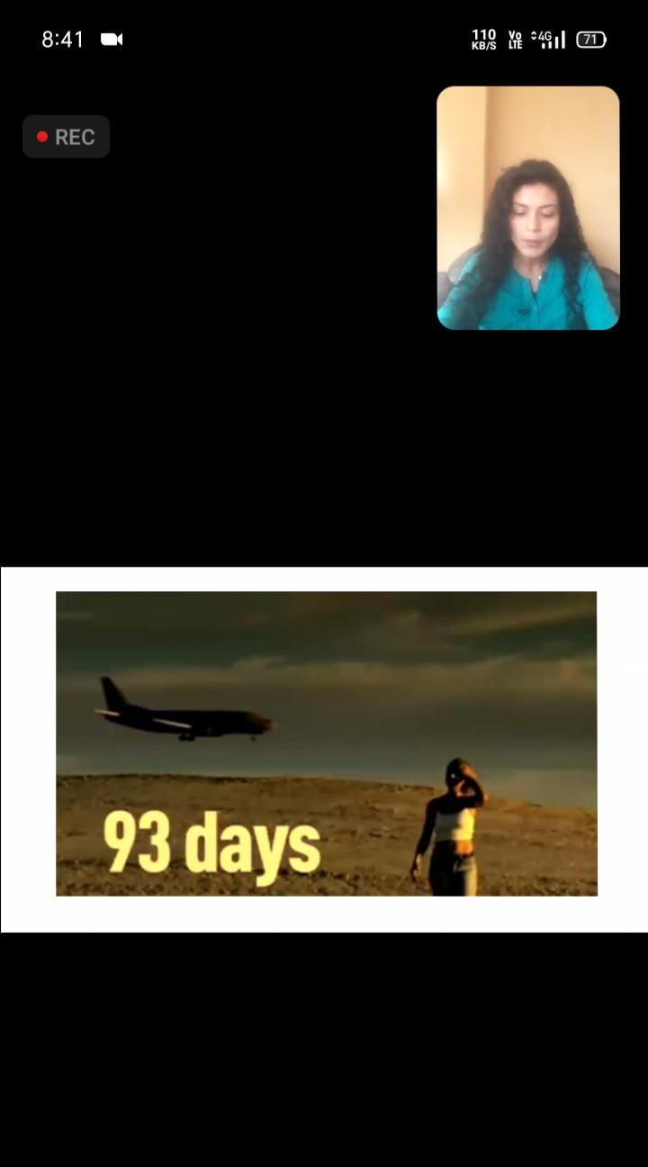
29 June 2022
Volunteers attended a webinar in association with world without war and violence
Notes:
Mxnnxxnx

Slide 9
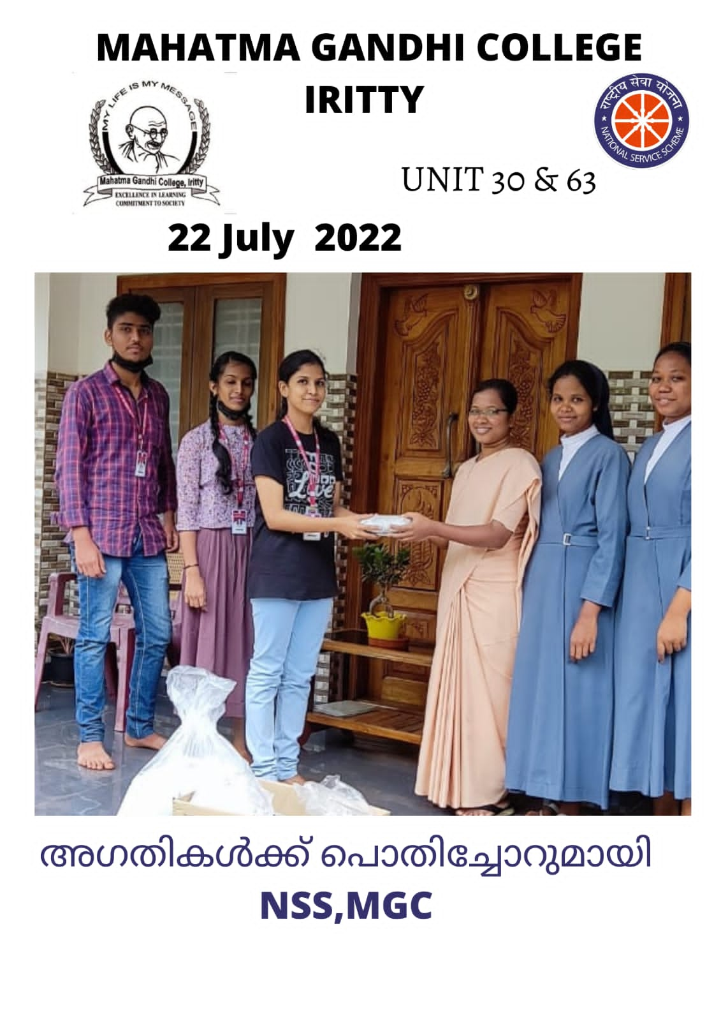
22 July 2022
‘Agathikalkku pothichor’
As part of the ‘Agathikalkku Pothichor’ programme, packed food was collected from volunteers and given to an orphanage.
Notes:
Mxnnxxnx

Slide 10
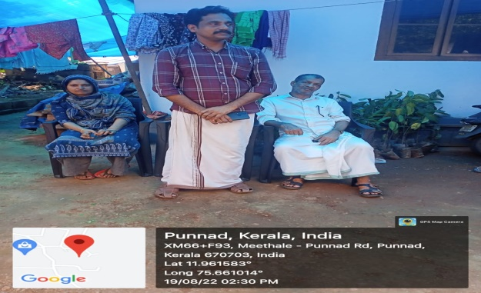
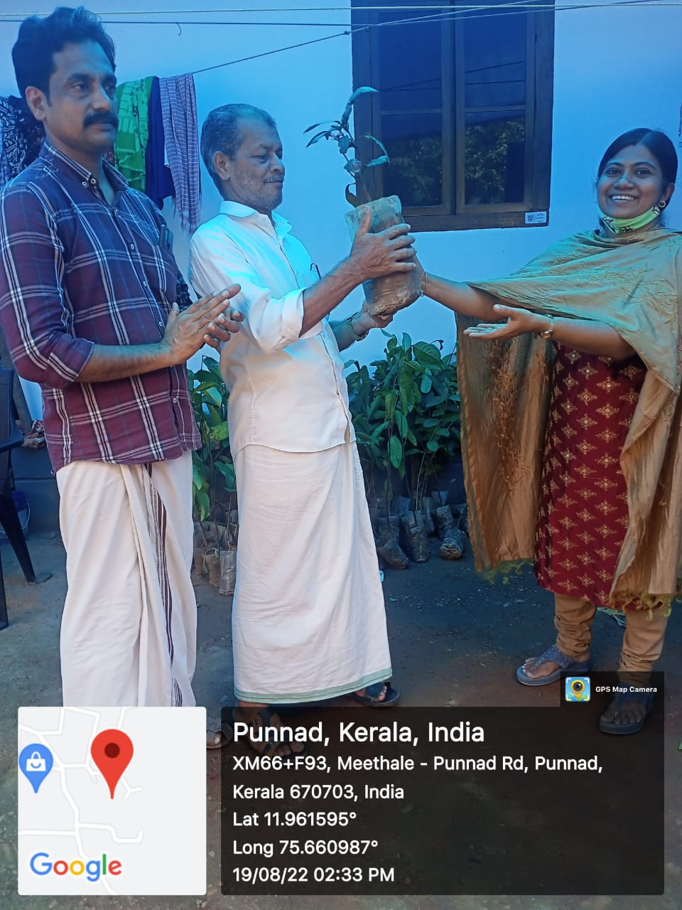
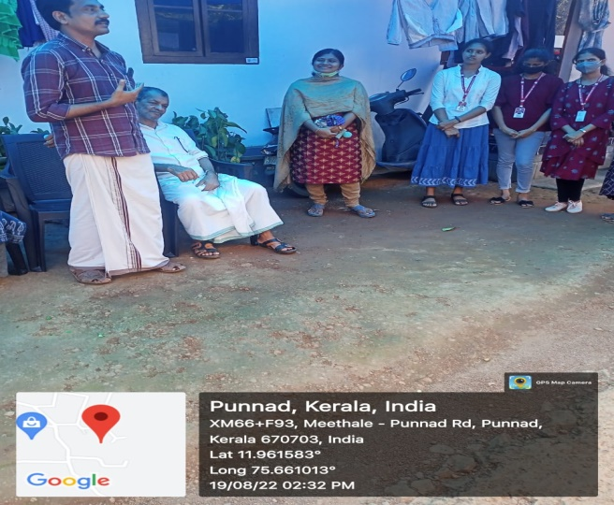
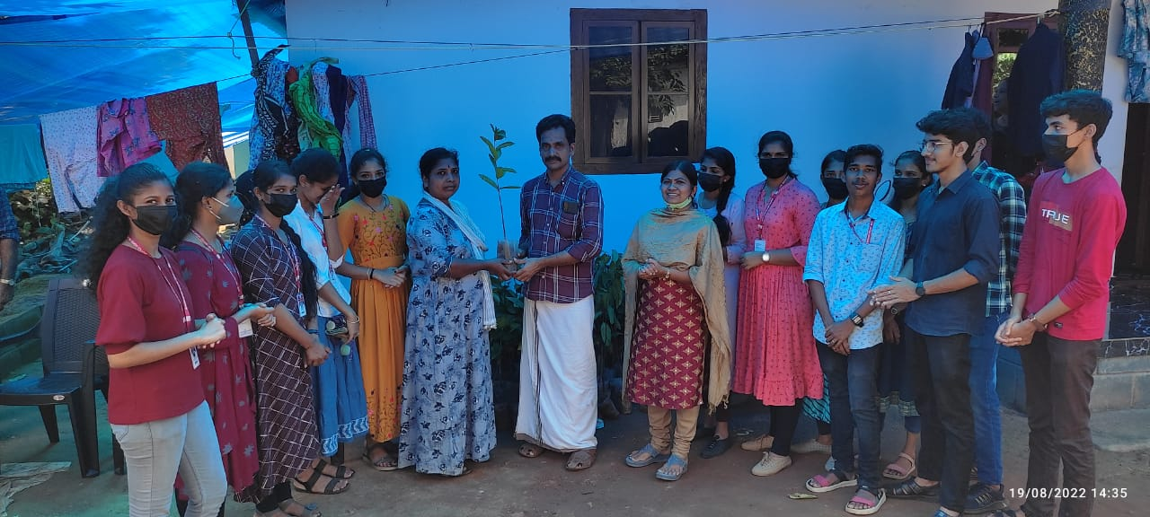
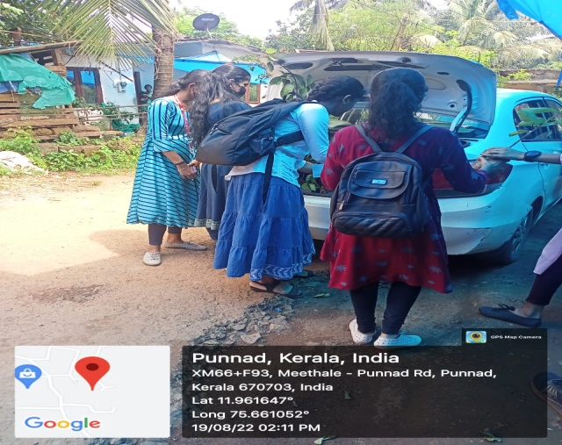
19 August 2022
Volunteers visited adopted village and distributed fruit tree saplings
Notes:
Mxnnxxnx

Slide 11
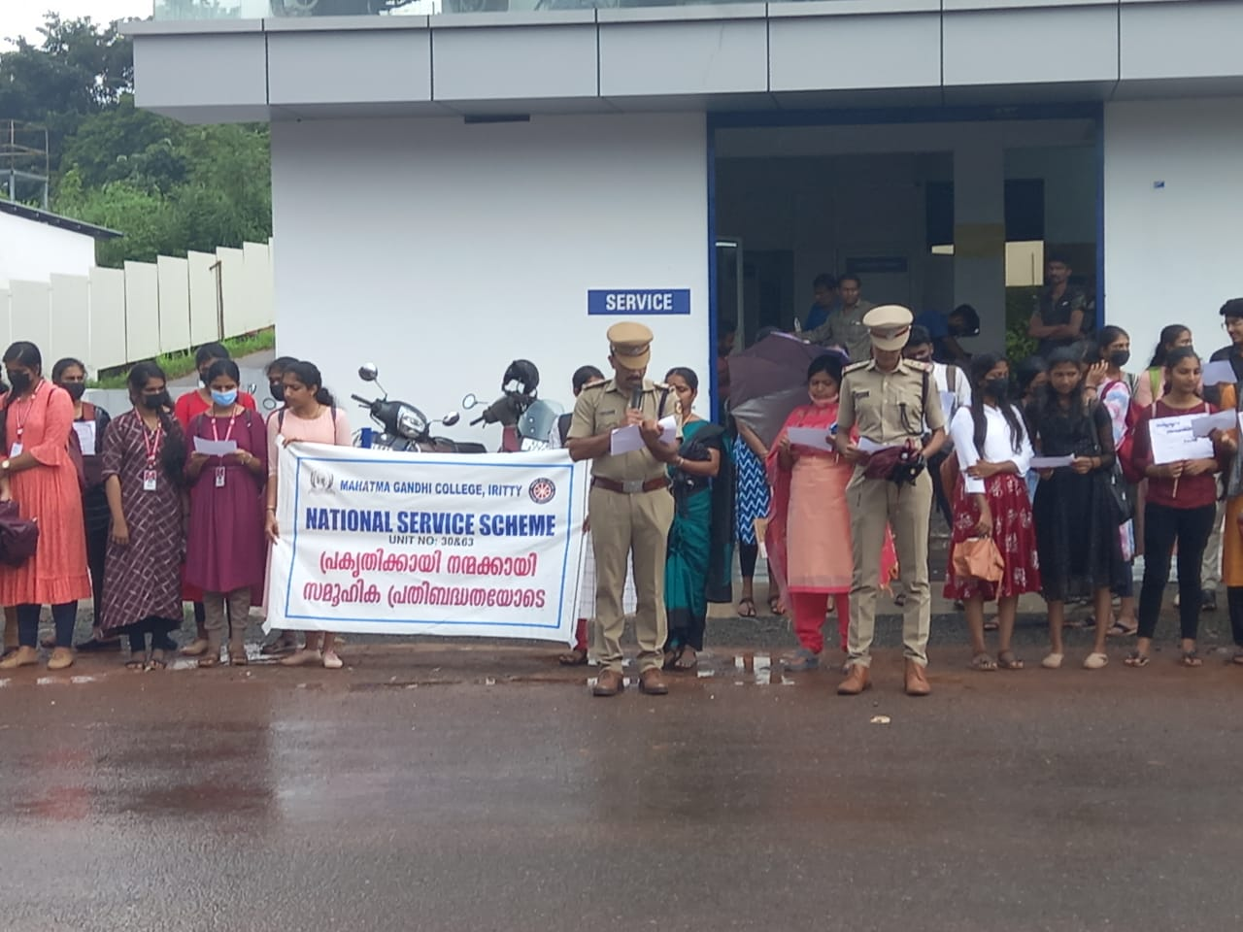
31 August 2022
Awareness Rally
Organised a drug awareness rally from college to college bus stop.
In association with the Excise Department, the volunteers took an anti-drug pledge.
Notes:
Mxnnxxnx

Slide 12
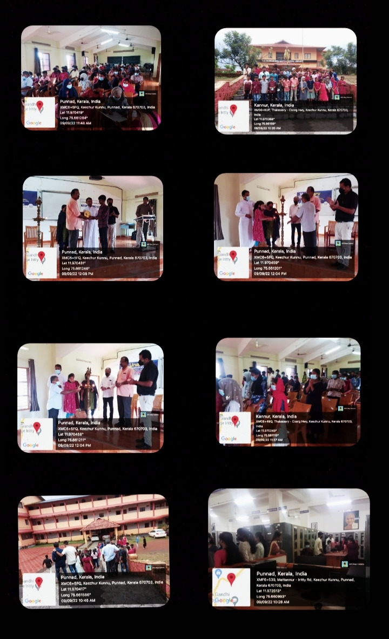
9 September 2022
‘Unarvu’ Programme
A one-day workshop ‘Unarvu’ was organized in the college to promote the learning activities of the children of inpatients. Around 45 students from class IV to Plus Two participated in the program under the leadership of Samaritan Trust-Nellikunnu.
Notes:
Mxnnxxnx

Slide 13
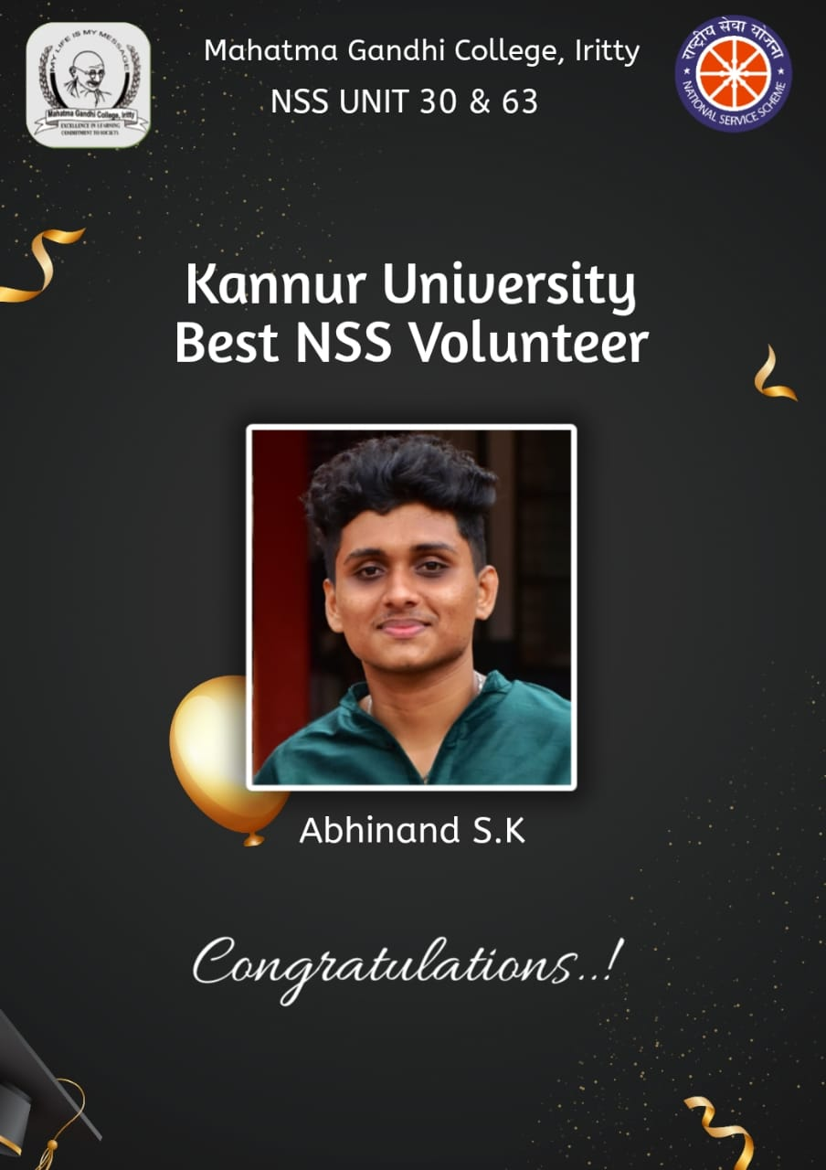
15 September 2022
Our volunteer Abhinand SK was selected as the best volunteer of Kannur University
Notes:
Mxnnxxnx

Slide 14
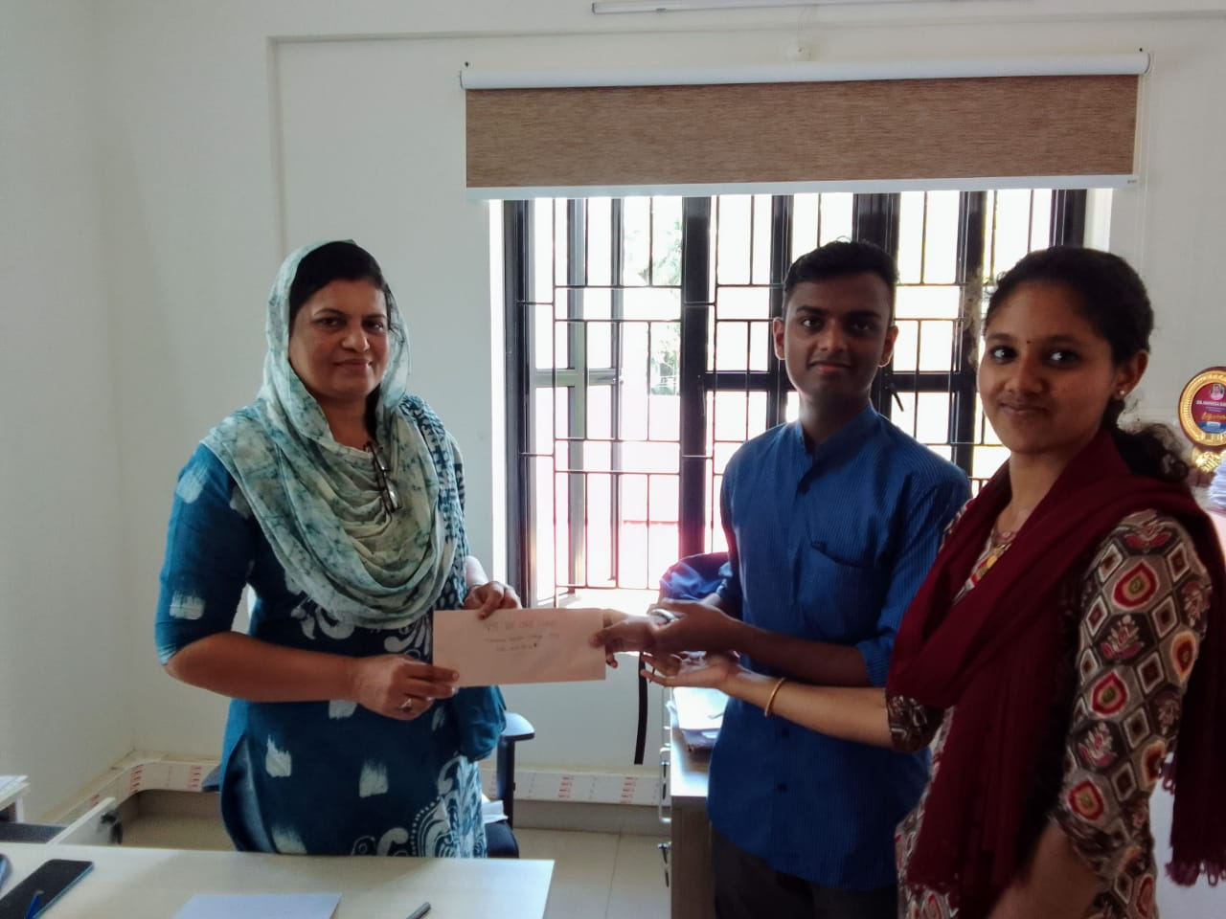
16 September 2022
We Care
Contribution to ‘we care’ programme by volunteers handovered to DSS
insta post
Notes:
Mxnnxxnx

Slide 15
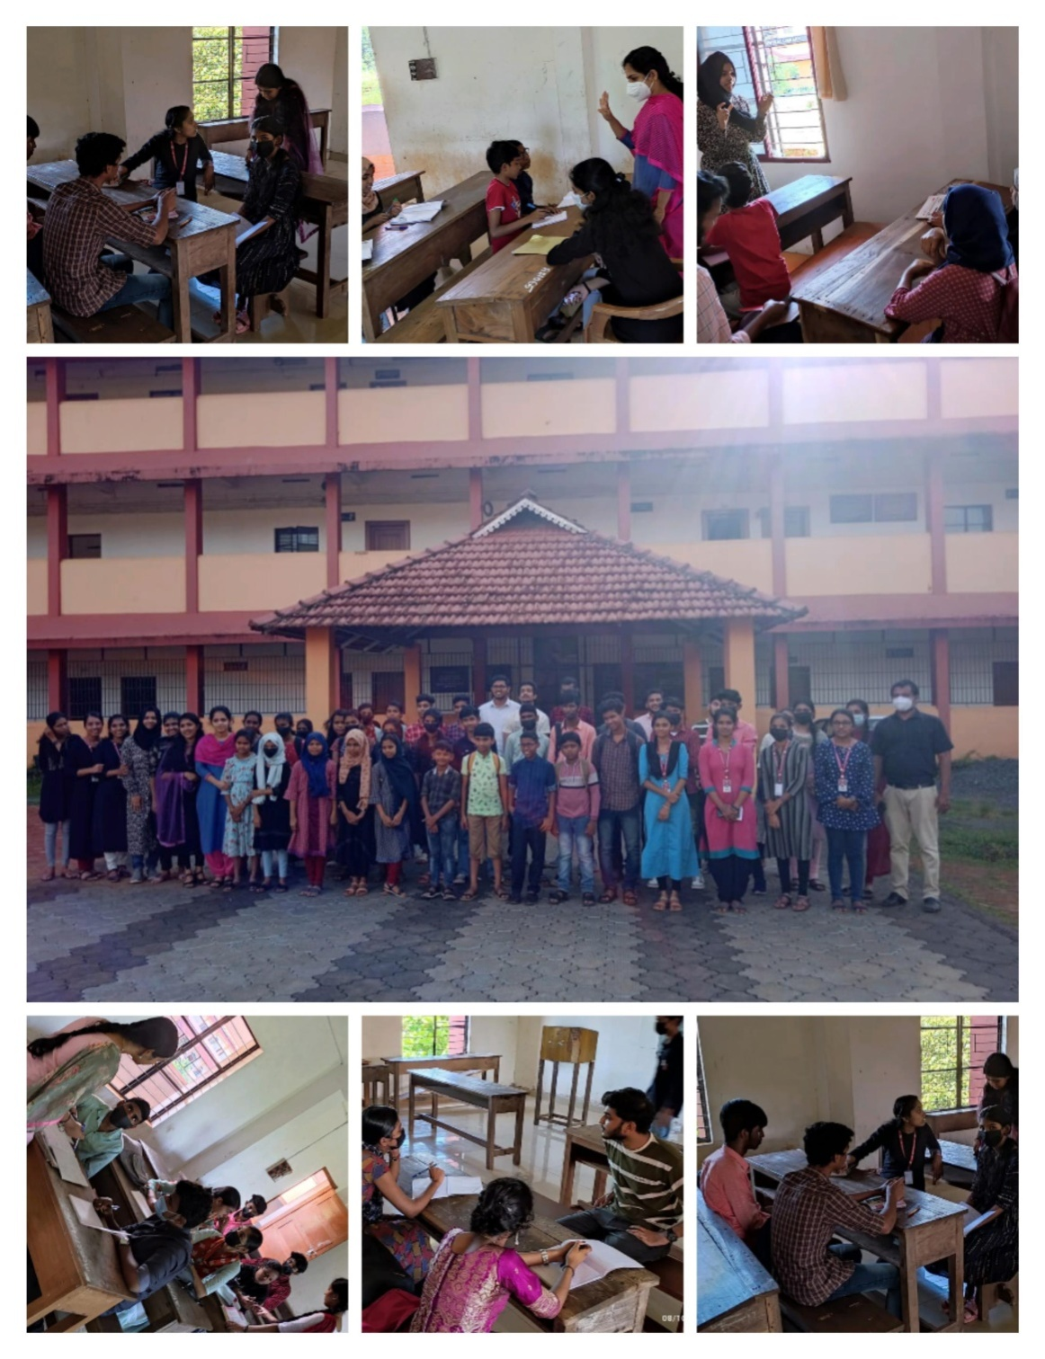
8 October 2022
‘Lalitham Ganitham’
Under the auspices of NSS units, a tuition program called ‘Lalitham Ganitham’ was organized to coordinate the learning activities of children of inpatients with the help of Mathematics PG Department.
Instagram Link of post
Notes:
Mxnnxxnx

Slide 16
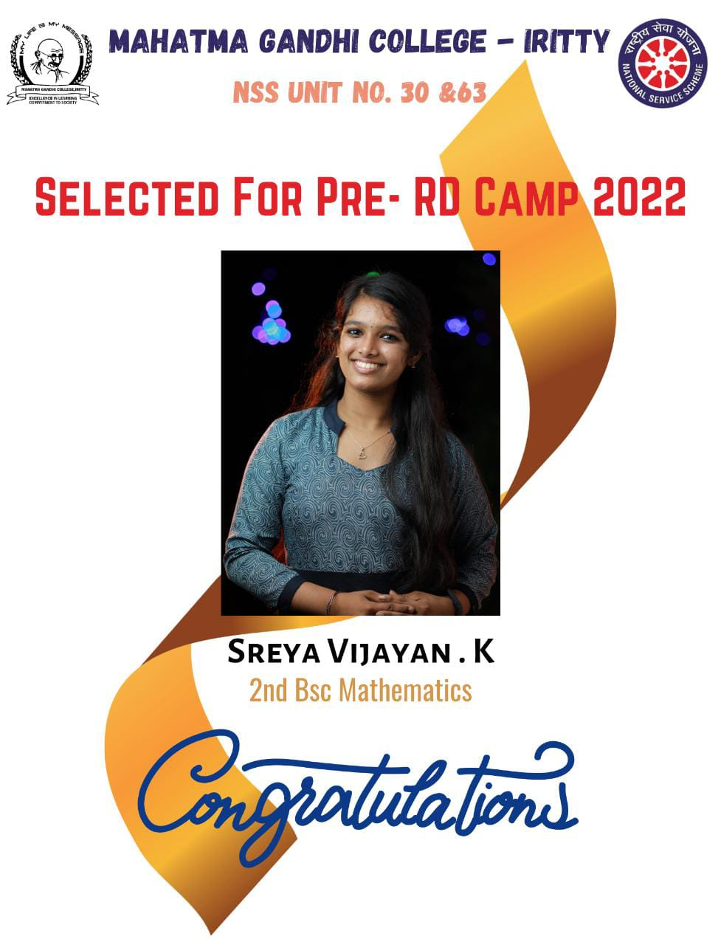
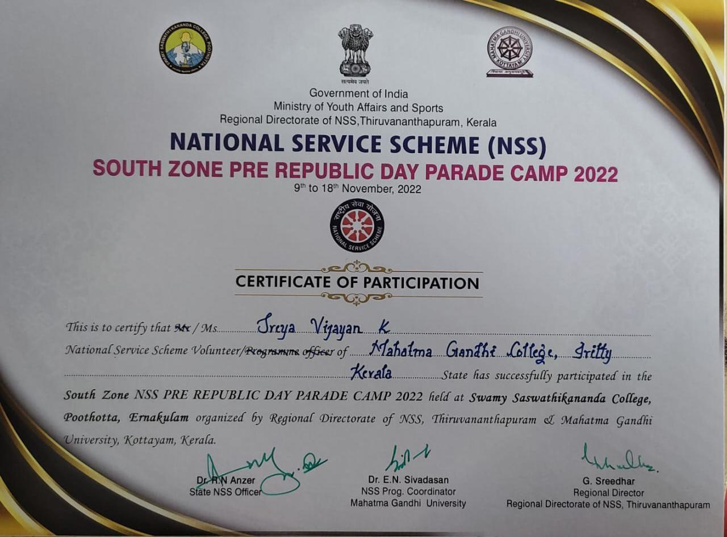
24 October 2022
Our Volunteer Sreya Vijayan K was selected to attend the Pre – RD CAMP 2022
Instagram Post
Notes:
Mxnnxxnx

Slide 17
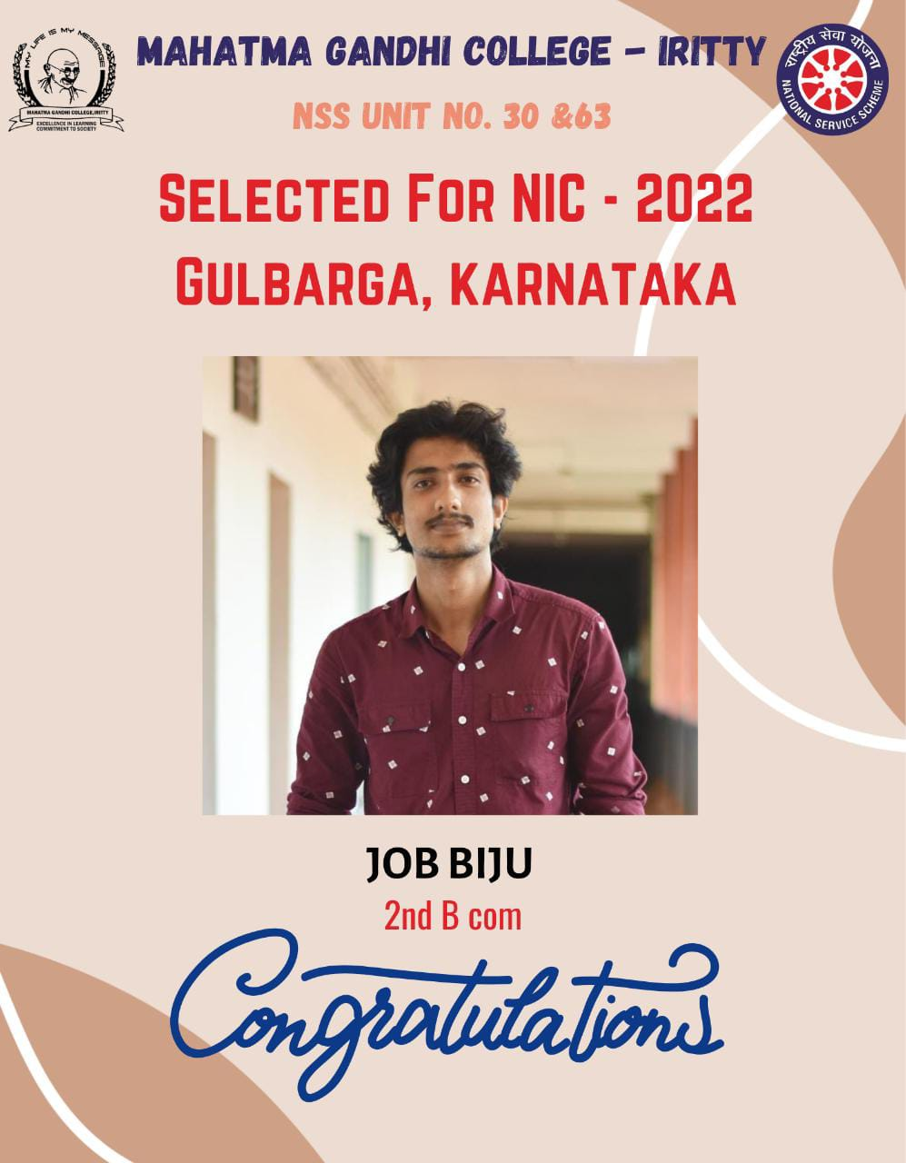
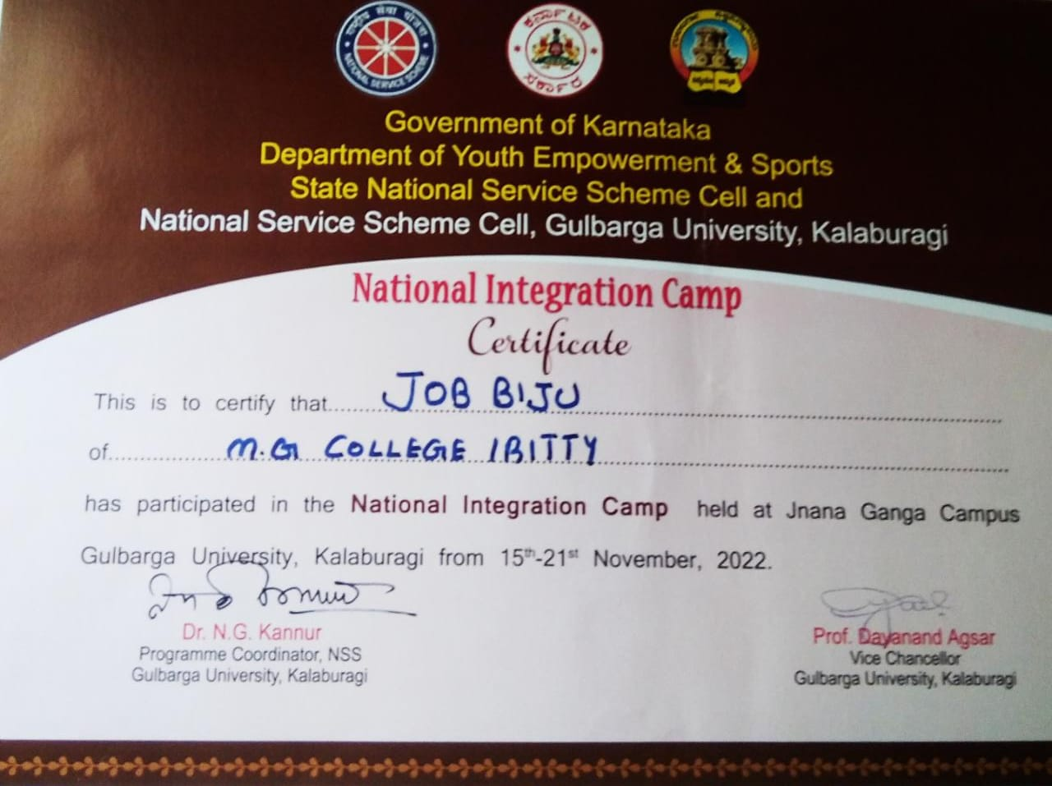
4 November 2022
Our volunteer Job Biju selected to attend NIC 2022 Gulbarga, Karnataka
Notes:
Mxnnxxnx

Slide 18
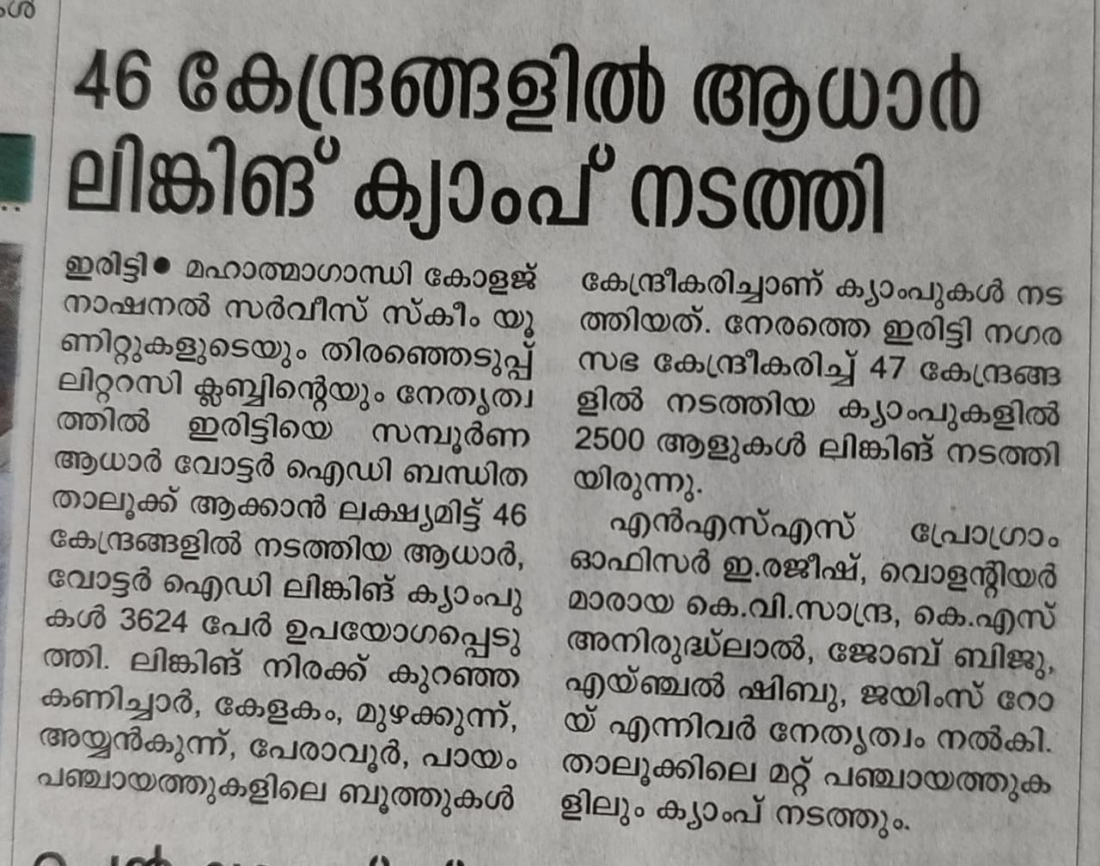
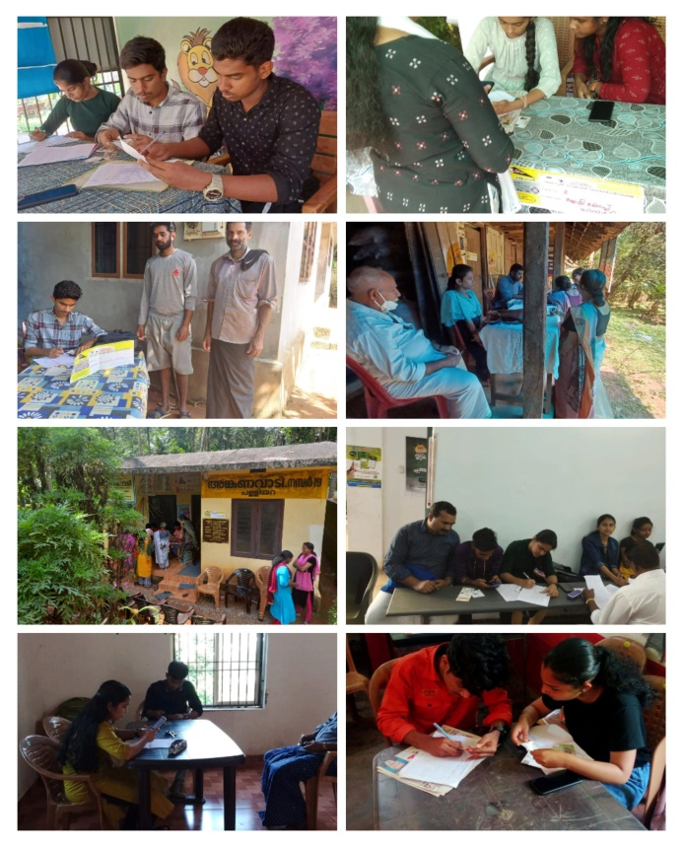
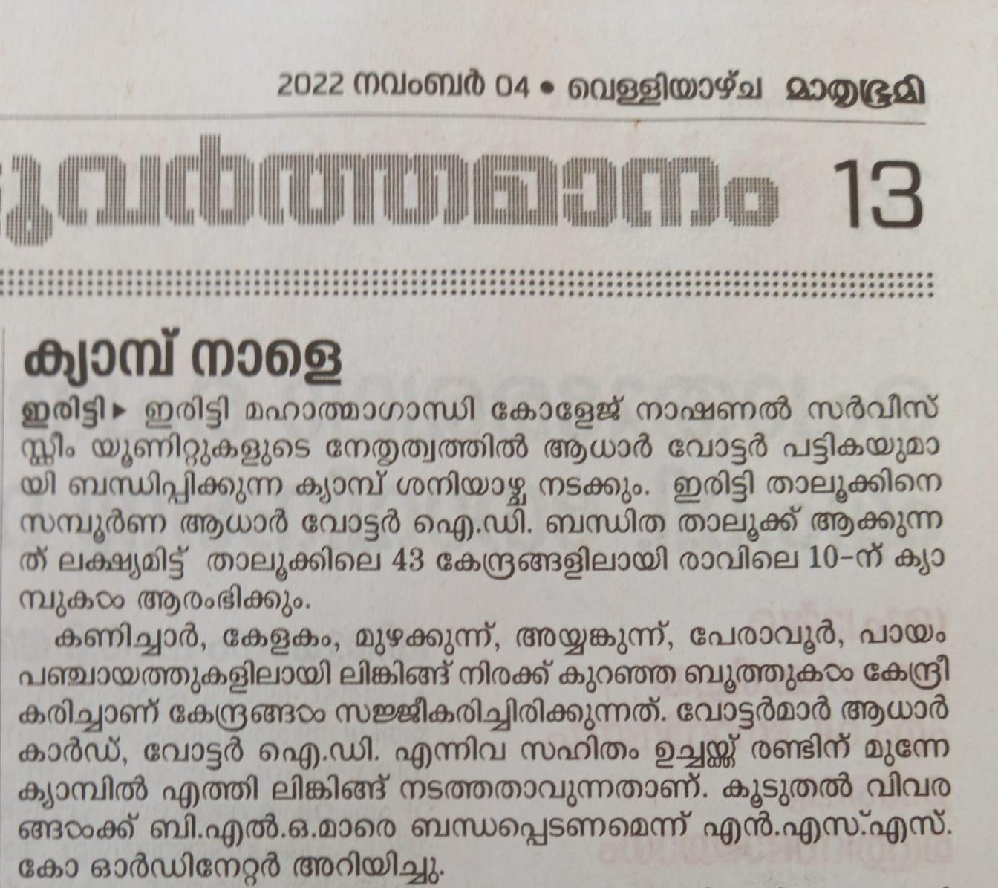
5 November 2022
Aadhar Voter ID Linking Camp
Organised second phase of Aadhar voter ID linking camp at Iritty Thaluk limit with the cooperation of thaluk election department.
Instagram link
Notes:
Mxnnxxnx

Slide 19
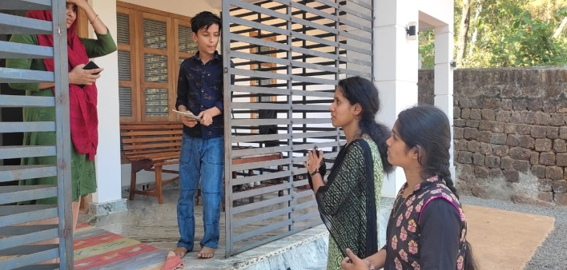
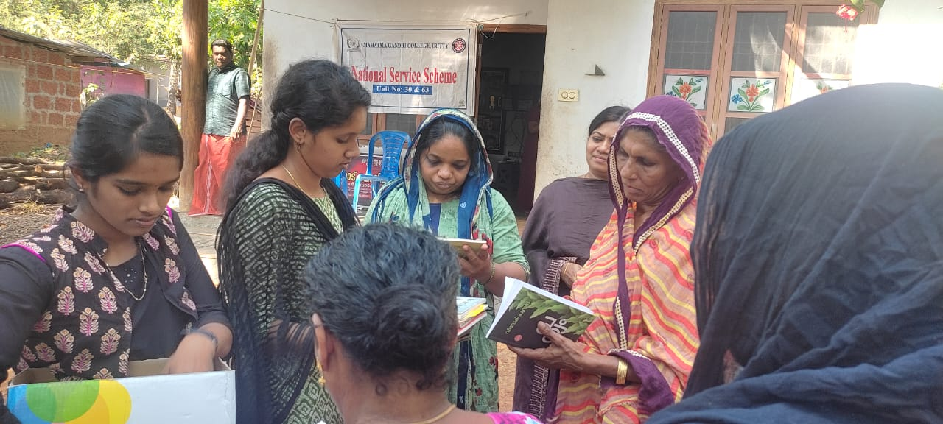
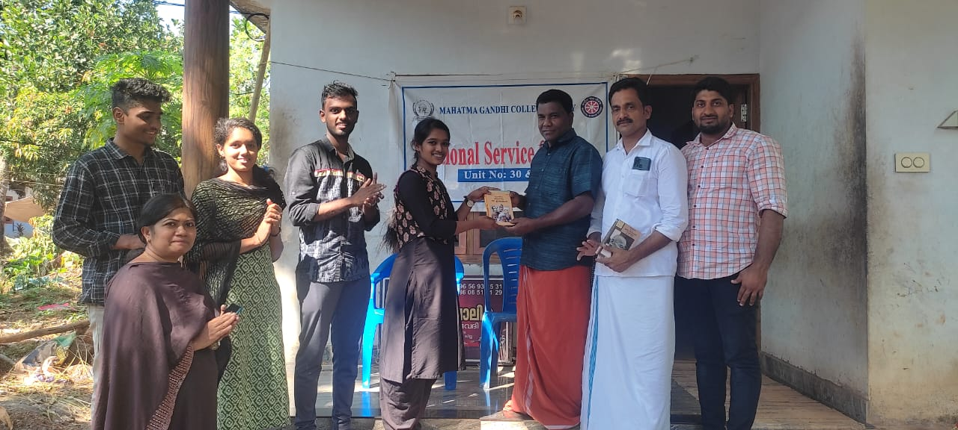
20 January 2023
`Pusthakathanal’
Distribution of books in the adopted village
Insta post link
Notes:
Mxnnxxnx

Slide 20
20 January 2023
Road safety awareness done by volunteers in the adopted village
Insta link
Notes:
Mxnnxxnx

Slide 21
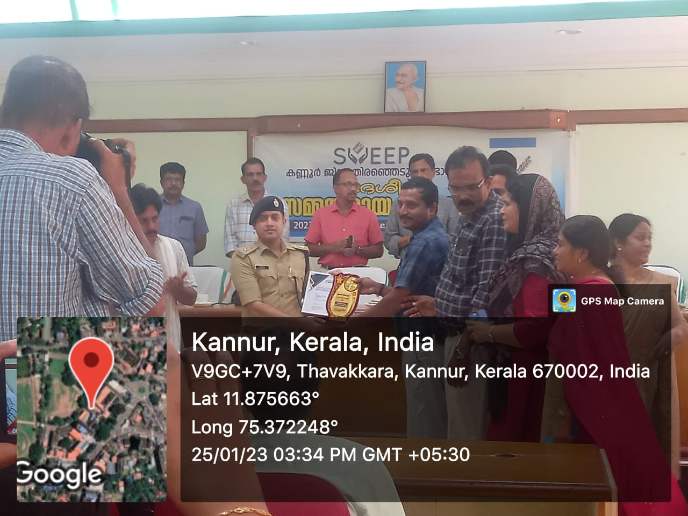
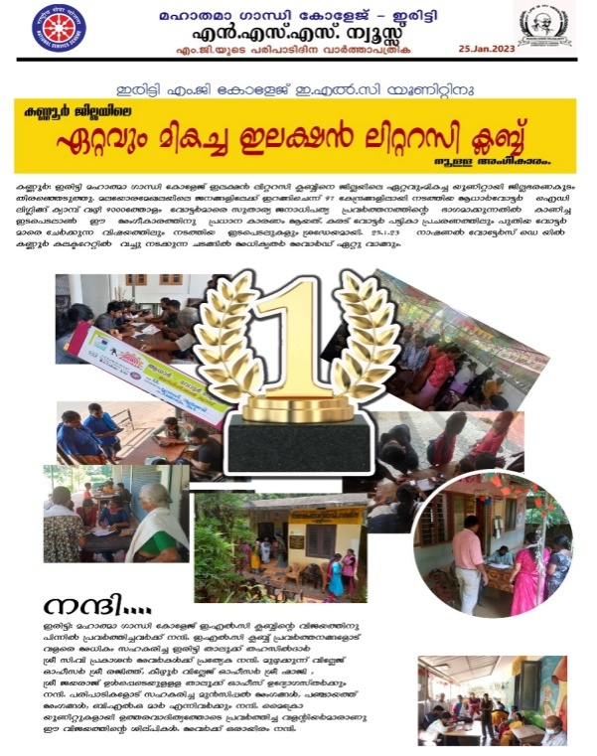
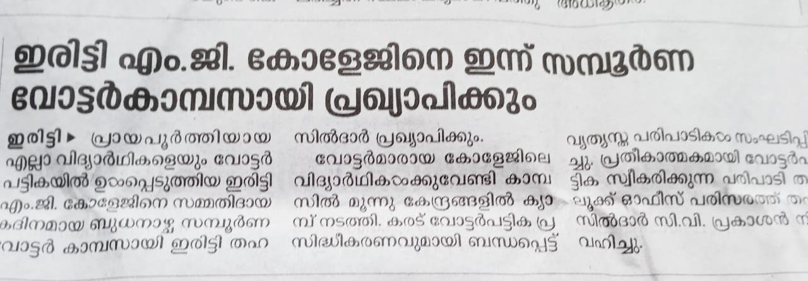
25 January 2023
Received best ELC unit award from collectrate
Notes:
Mxnnxxnx

Slide 22
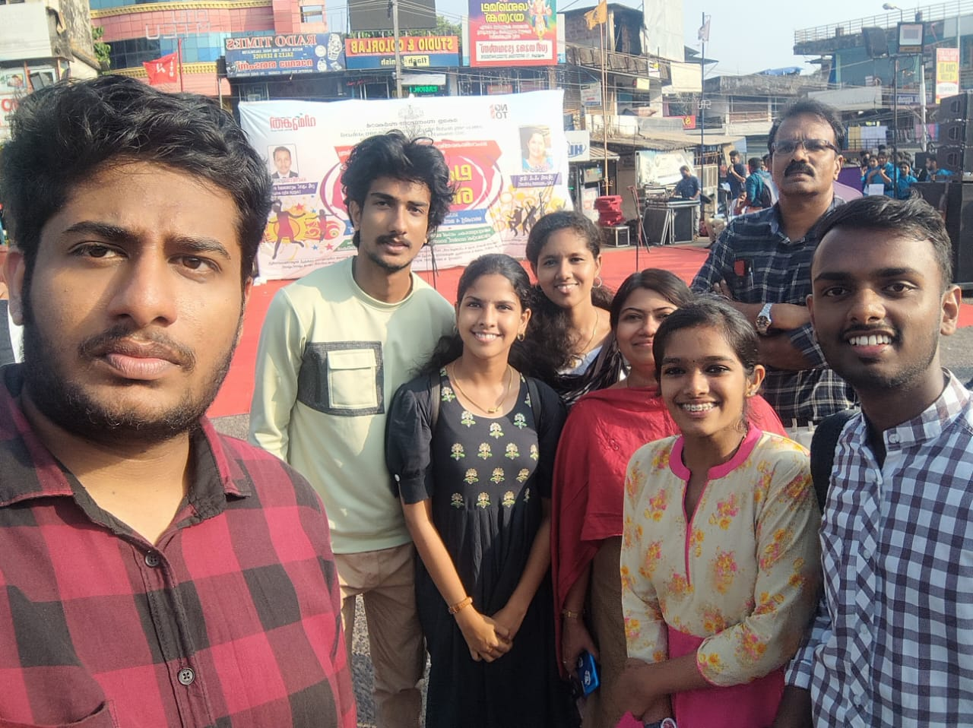
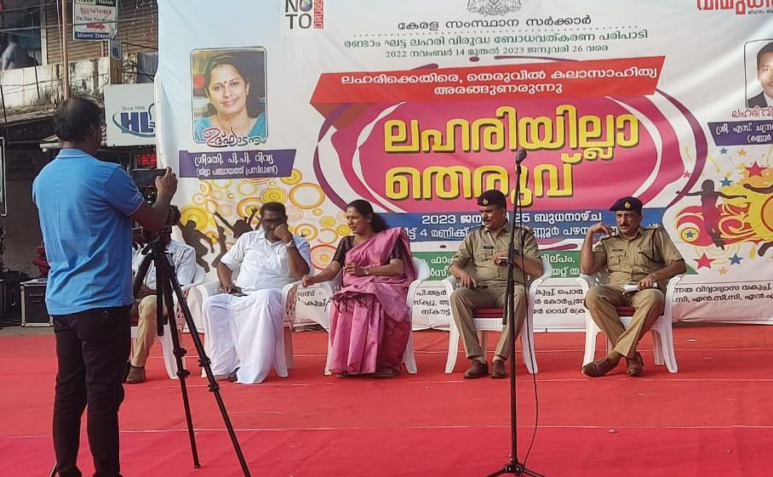
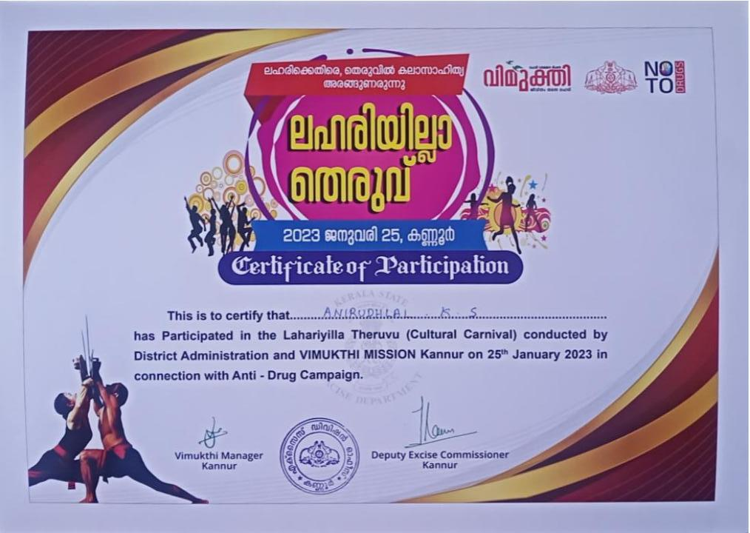
25 January 2023
The NSS volunteers of Iritty MG College participated in the anti-drug awareness program conducted at Kannur old bus stand as part of Vimukthi mission of the Kerala state government and participated in flashmob competition
Flashmob Video
Notes:
Mxnnxxnx

Slide 23
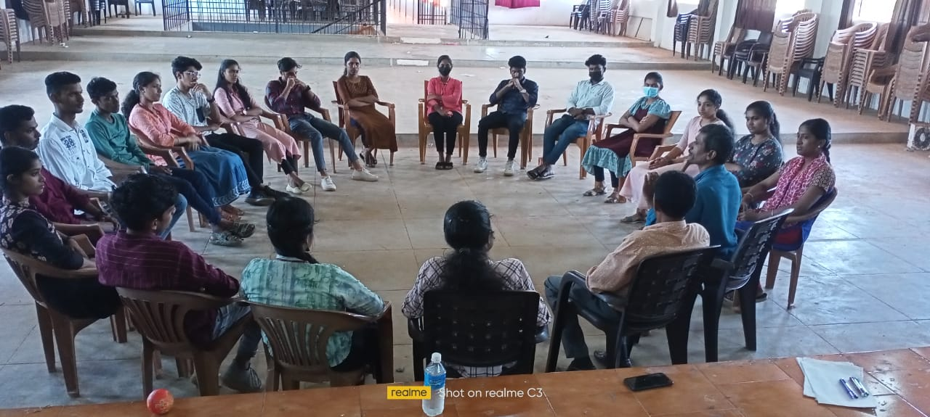
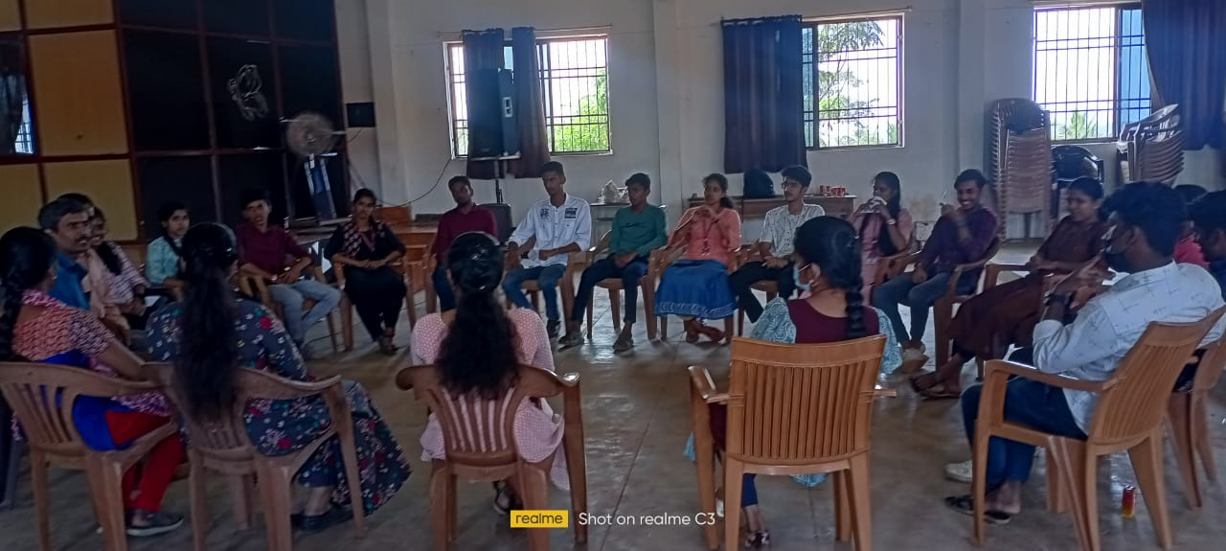
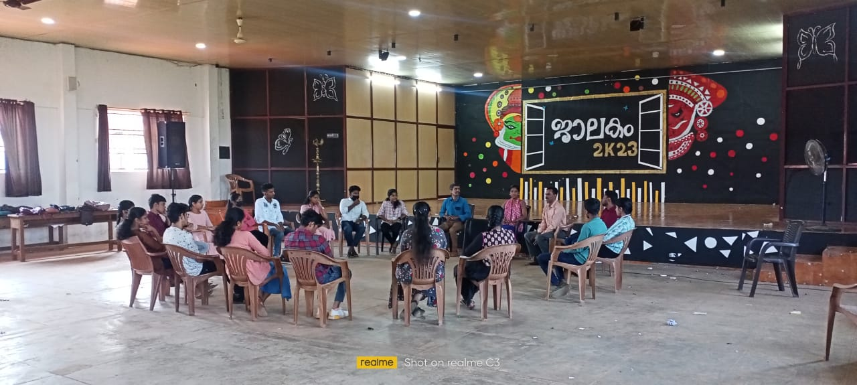
26 January 2023
‘Zero Violence Mindset’
In association with the WWWV,organized a Workshop - Zero Violence Mindset for the volunteers
Notes:
Mxnnxxnx

Slide 24
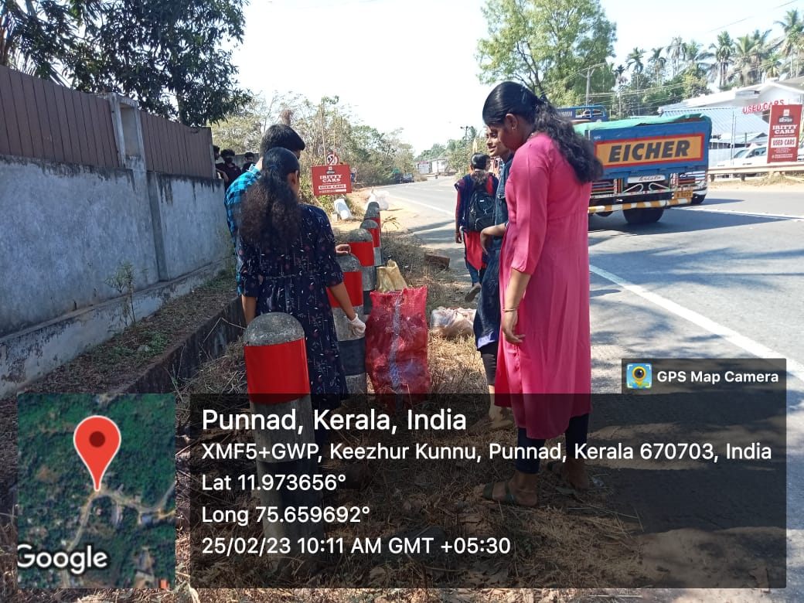
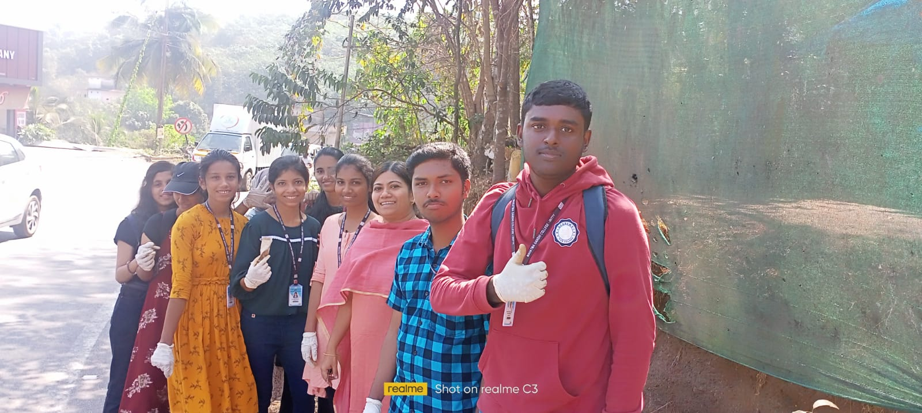
25 February 2023
`Garbage Free District’ Programme
Volunteers cleaned the roadsides near Keezhurkunnu as part of the ‘Garbage-Free District’ programme- part 1
Notes:
Mxnnxxnx

Slide 25
25 February 2023
Survey
Volunteers done biodiversity survey in the adopted village
Notes:
Mxnnxxnx

Slide 26
28 February 2023
National Science Day
On the occasion of National Science Day, volunteers done different experiments for the children of nearby school at keezhur to impart science awareness to the students.
Notes:
Mxnnxxnx

Slide 27
17 March 2023
10 Rupees Challenge
Volunteers collected a fund to help a cancer patient near college
Notes:
Mxnnxxnx

Slide 28
21 March 2023
10 Rupees challenge fund for cancer patient was handed over to College Head Accountant Santhosh.
Notes:
Mxnnxxnx

Slide 29
24 March 2023
Visited Merilack orphanage and distributed dress collected by volunteers.
Notes:
Mxnnxxnx

Slide 30
1 April 2023
`Garbage Free District’ Programme
Volunteers cleaned the roadsides near Keezhurkunnu as part of the ‘Garbage Free District’ Programme – part 2
Notes:
Mxnnxxnx

Slide 31
5 May 2023
`Zero Violence Mindset’
Conducted `Zero Violence Mindset’ workshop part 2 in association with WWWV
Notes:
Mxnnxxnx

Slide 32
6 May 2023
Webinar
Conducted a Webinar on ‘Social Evolution’ in association with WWWV.
Notes:
Mxnnxxnx

Slide 33
24 May 2023
Webinar
Conducted webinar on `Success,Failure and Direction of Life’ in association with WWWV
Notes:
Mxnnxxnx

Slide 34
27 May 2023
`Zero Violence Mindset’
Attended the concluding ceremony of ‘Zero Violence Mind Set’ – Course ,inaugurated by Shri Chandrasekhar S. I.A.S (Kannur District Collector) in association with WWWV at Kannur
Notes:
Mxnnxxnx

Slide 35
zero violence mindset-WWWV(ngo)
agathikalk podichor
Pusthakathanal
Pre-monsoon cleaning
Garbage free district
Dress distribution to old age home
Donation to cancer patient
Science day
Biodiversity survey
Antidrug awareness
Voter id -adhar linking camps
Free tuition-unarv
Free tution-lalitham ganitham
We care programme
Ditribution of fruit saplings in adopted village

